Slide 1
Image Captioning
Debangshu Bhattacharya
Nilanjan Debnath
Nilanjan Debnath

Slide 2
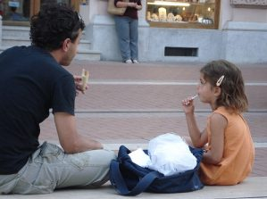
What is Image Captioning:-
Suppose we see this image:
What is the first thing that comes into our mind?

Slide 3
A man and a girl sit on the ground and eat .
A man and a little girl are sitting on a sidewalk near a blue bag eating .
A man wearing a black shirt and a little girl wearing an orange dress share a treat.
Automatically generating this kind of textual description from an artificial system is the task of image captioning.
The generated output is expected to describe in a single sentence what is shown in the image – the objects present, their properties, the actions being performed and the interaction between the objects, etc.

Slide 4
Use cases of Image Captioning
Image captioning not only helps in problems like automatic captioning of large datasets, but in real life helps in activities like helping blind people interpret an image without external help. Some of the domains where image captioning has found its applications are as follows:
Self Driving cars for scene understanding.
Aid to the blind
Google image search
Cctv Security

Slide 5
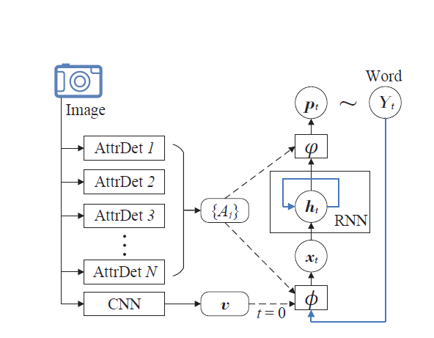
Structure of an Image Captioning model

Slide 6
Building an Image Captioning System

Slide 7
Step 1: Preprocess captions
Since an integral part of the image captioning model is the decoder which is a language model, preprocessing the training captions is an important step for a better language model.
We performed the following preprocessing for our experiments:
Tokenize words based on NLTK’s word tokenize module.
Lower case folding.
Remove punctuations.
Remove all characters but alphabets. This removes all special characters, digits, etc.
An example of preprocessed caption:
Original caption: A child in a pink dress is climbing up a set of stairs in an entry way
Preprocessed caption: a child in a pink dress is climbing up a set of stairs in an entry way

Slide 8
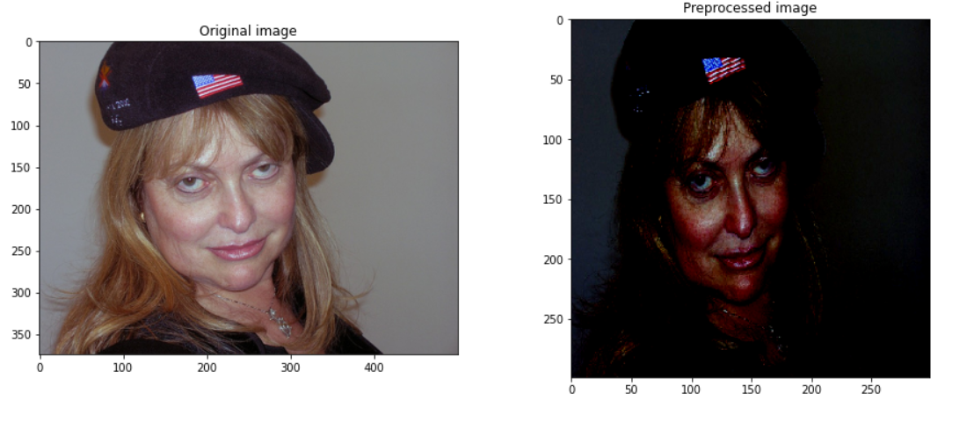
Step 2: Preprocess Images
Building a vision model requires good image preprocessing steps.
Since, our encoder model (vision model) is based on Transfer Learning from the pre-trained Inception model, the preprocessing steps are defined as:
Resize to target size 299 x 299 x 3
Normalize to range -1 to 1 for pixel values.
An example is shown below:

Slide 9
Step 3: Build Model

Slide 10
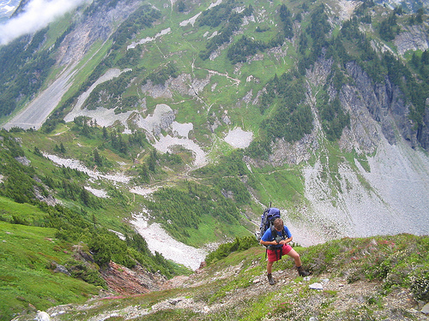
Getting started with a basic model: Encoder
Transfer learning to get feature vector
(Non trainable component)
Train a dense layer to get encoded vector
preprocess
Preprocessed image
FC layer
Encoded vector
Image
Inception v3 weights (without last layer)
Feature vector

Slide 11
Encoder without Transfer Learning
Parametric model (example CNN)
Store the set of most common words in the captions (without stopwords) as labels of the whole dataset.
For each image see which labels are present.
Treat it as a multilabel classification problem.
Non parametric model
Nearest image retrieval from a large collection of images with rich metadata (tags and captions).

Slide 12
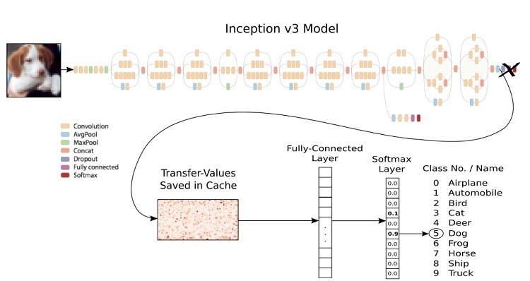
Inception V3 Architecture

Slide 13
Getting started with a basic model: Decoder
Vector Representation of Texts
To represent the text as a vector we need to follow these steps:
Build vocabulary from train set. Add <pad> token to vocabulary.
Find maximum length of train set captions. (length = number of words)
Represent the text as a vector of numbers:
Each number is the index of the corresponding word in the text.
Pad rest of the indices with the index of <pad> token.
Example:
Let the vocabulary be <”pad”, ”hello”, “how”, “is” ,”are”, “you”…...> a vector of length 1000.
Let the text be “How are you”.
Let maximum length of caption be 5. (Train captions corpus has a maximum of 5 words for a particular caption)
The representation will be: [2, 4, 5, 0, 0]

Slide 14
Getting started with a basic model: Decoder
Partial Sequence Vector
An input to the decoder model is a partial sequence vector which is a text vector representation of a part of the caption.
For example, the text “<s> Hello how are you </s>” can be divided into following partial sequences:
“<s>”
“<s> Hello”
“<s> Hello how”
“<s> Hello how are”
“<s> Hello how are you”
“<s> Hello how are you </s>”
The numeric vector representation of such partial sequences give us the partial sequence vector.

Slide 15
Getting started with a basic model: Decoder
The decoder receives the CNN encoded feature vector and the partial captions sequence vector.
It predicts the next word given these two inputs.
The architecture of our decoder is as follows:
Lstm feature vector
Embedding
FC layer
LSTM
CNN encoded vector
Partial sequence vetor
Predicted next word probability vector
Concat

Slide 16
Step 4: Building data generator
For a particular image there are 5 captions in the dataset.
For each caption, suppose the caption has m tokens (including start and end token). Then, that caption has m partial sequence vectors.
The decoder needs the image encoding and partial sequence vector to predict next word.
For one image and one caption, m copies of the image encoding thus needs to be stored in memory. Multiply that by 5 to get the whole dataset!
So, storing the whole dataset in memory is out of question even if we assume m is low on average.
So, we need a datagen function which generates the data in batches.
The model is trained on these batches instead.

Slide 17
Experiments
First trained on 100 images of flickr30k to test working soundness.
For rest of experiments, used the flickr8k dataset (https://www.kaggle.com/adityajn105/flickr8k) which consists of 8091 images.
Trained on 70% of flickr8k dataset and tested on 30%.
Caption generation: GreedySearch and BeamSearch.
Evaluation: BLEU (Bilingual Evaluation Understudy) and METEOR (Metric for Evaluation of Translation with Explicit Ordering) score.

Slide 18
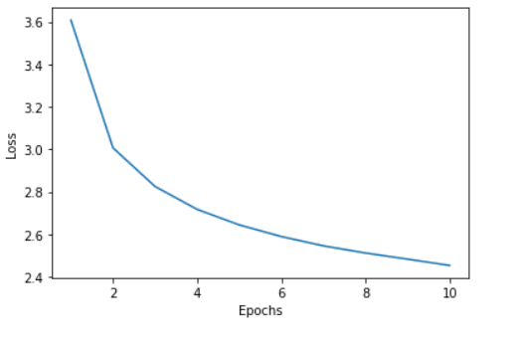
Step 5: Train
The dataset was split into a 70-30 train test split.
Datagen function was used to generate batches with 30 images per batch.
Trained on 10 epochs.

Slide 19
Step 6: Generate caption
The decoder model generates a vector of length vocabulary size with each element of the vector indicating the probability of the next word given the partial sequence upto that word and the image encoded vector as inputs.
So, the idea is that we start from the partial sequence with only start token and generate first word.
Then we take partial sequence of start token, first word and generate 2nd word.
Iterate till we reach end token or till it reaches maximum caption length.
We have used two strategies to choose the next word from the probability vector given by the decoder:
Greedy Search
Beam Search

Slide 20
Step 6: Generate caption
Greedy Search
Use the word with the maximum probability as the next word.
Beam Search
Beam width, k = 3.
Instead of picking the word with maximum probability as next word, pick the top k words and add it into candidates for next partial sequence.
Iterate over till you get a lot of candidate generated captions.
Pick the top k most ‘likely’ captions,i.e, the captions which has the highest k joint probabilities.
Since, a lot of partial sequences may be taken up in memory, we can remove those which has lower product of probabilities or likelihoods.

Slide 21
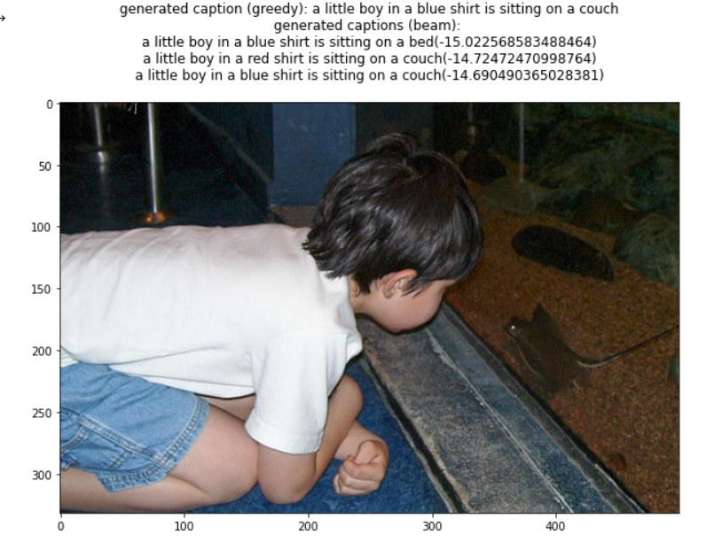
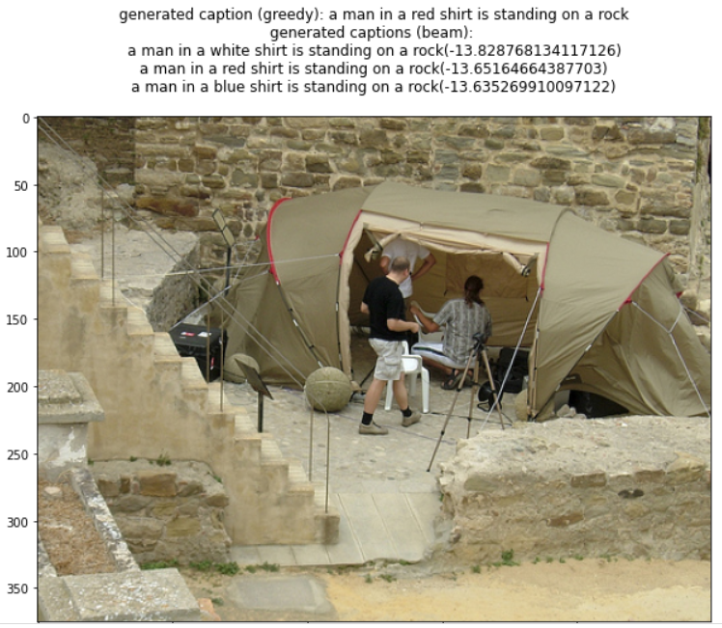
Step 6: Generate caption (Some Results)

Slide 22
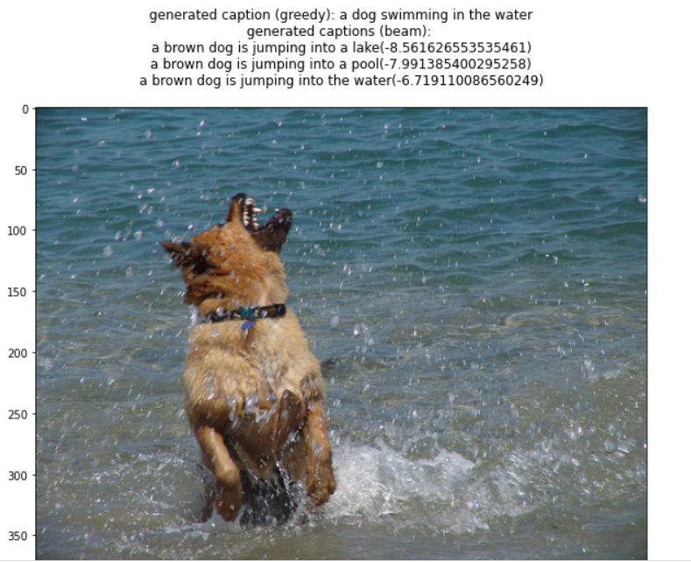
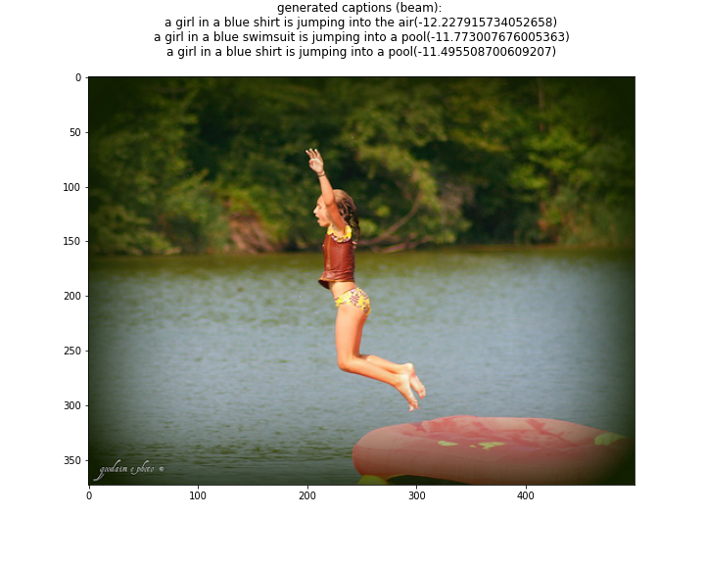
Step 6: Generate caption (Some Results)

Slide 23
Step 7: Evaluate
Test set consisted of 2428 images.
First compared scores for first 200 test images
Greedy Search:
BLEU B-1: 0.549
BLEU B-2: 0.35
METEOR: 0.353
Beam Search:
BLEU B-1: 0.553
BLEU B-2: 0.34
METEOR: 0.36
Also noted average scores for whole test set:
BLEU B-1: 0.54
BLEU B-2: 0.33
METEOR: 0.34

Slide 24
Model Evaluation: BLEU Score
Bi-Lingual Evaluation Understudy.
Evaluates the quality of text generated by a machine compared to ground truth human text references.
Value is always between 0 and 1 indicating how ‘similar’ the machine produced text (candidate) is compared to human standards (references).
Two types:
Individual: BLEU score of an individual n-gram which is a modified precision score of that n-gram.
Cumulative: weighted average (weighted geometric mean) of individual BLEU scores of 1-gram, 2-gram, 3-gram and 4-gram...N-grams.

Slide 25
Model Evaluation: BLEU Score Computation
Let’s say our references sentences are “the cat is on the mat” and “there is a cat on the mat”
Let our generated sentence be “the the the the the the the”
Let’s consider for unigrams the precision and modified precision scores.
Precision
Fraction of output words which are present in references: 7/7 = 1 (Not useful)
Modified Precision:
Idea: Clip the count of a word to the maximum number of times it appear in a particular reference sentence. Let this be denoted by R(w). Here, R(the) = 2.
“the” appears a maximum of twice in a reference sentence. So, coverage(the) = min(count(the), R(the)) = 2.
Modified Precision = 2/7.

Slide 26
Model Evaluation: BLEU Score Computation (Continued)
Let’s consider the case for bigrams. The references are still “the cat is on the mat” and “there is a cat on the mat”. Let our generated sentence be “the cat the cat on the mat”
Bigram modified precision = (1+0+1+1+1)/(2+1+1+1+1) = 4/6 = 0.67
Bigrams | the cat | cat the | cat on | on the | the mat
Count | 2 | 1 | 1 | 1 | 1
Clipped count | 1 | 0 | 1 | 1 | 1

Slide 27
Model Evaluation: BLEU Score Computation (Continued)
But what if the model learns that generating shorter sentences gives better BLEU score.
Brevity Penalty (BP) :
This is usd to adjust the modified precision score.
BP = 1 if generated sentence length greater than reference sentence length,
BP = exp(1 - reference_sentence_length/candidate_sentence_length) otherwise
Bleu score:
BLEU = BP * exp( ∑w_n log(p_n) )
where p_n = n-gram modified precision score
W_n is the weights of the n-grams that we want to consider.

Slide 28
Model Evaluation: METEOR score
Metric for Evaluation of Translation with Explicit Ordering.
Metric is calculated using harmonic mean of unigram precision and recall.
Recall is weighted higher than precision. (9 times)
Matching by performing stemming and synonym matching is also performed.
Past Results presented indicate METEOR score has a correlation of upto 0.964 with human judgement whereas BLEU has a correlation of upto 0.817.
(Source: https://en.wikipedia.org/wiki/METEOR)

Slide 29
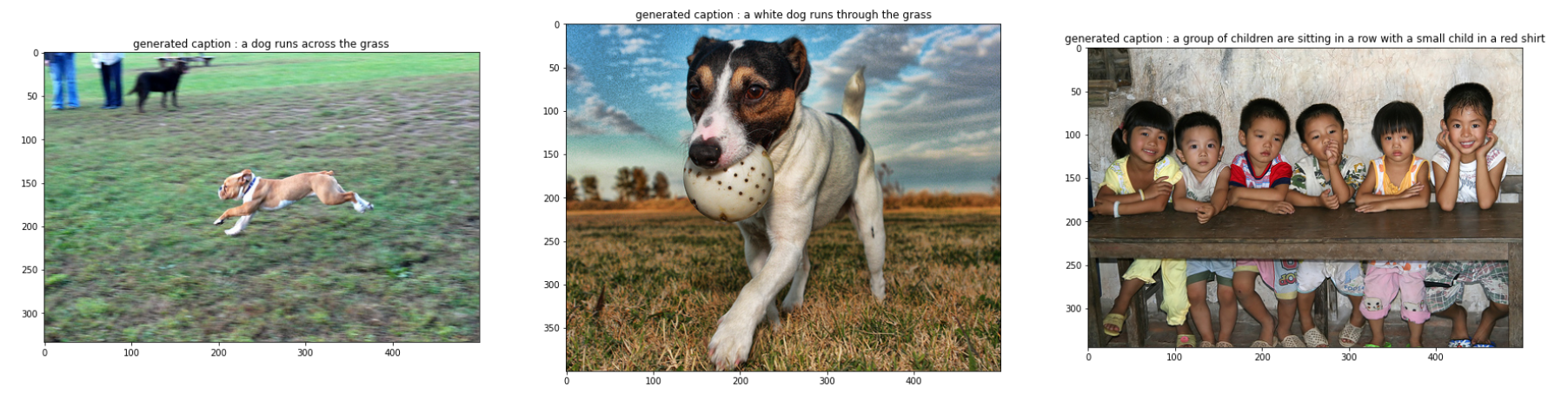
Some Results

Slide 30
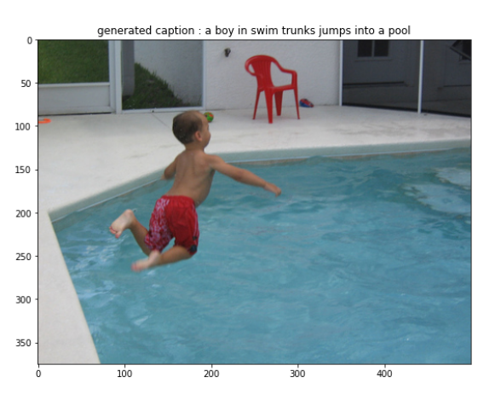
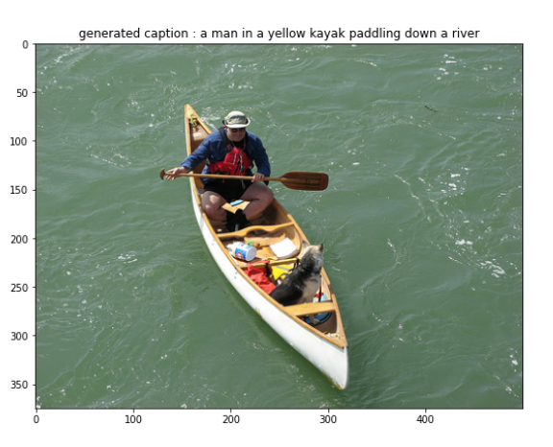
Some Results

Slide 31
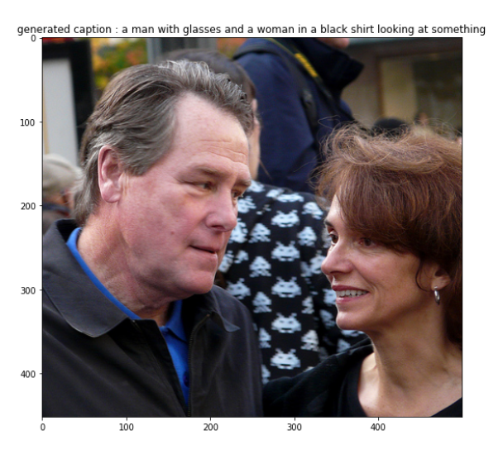
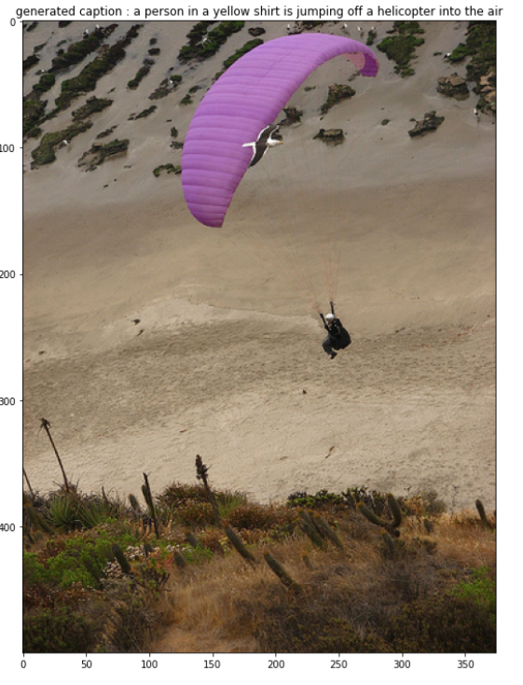
Some Results

Slide 32
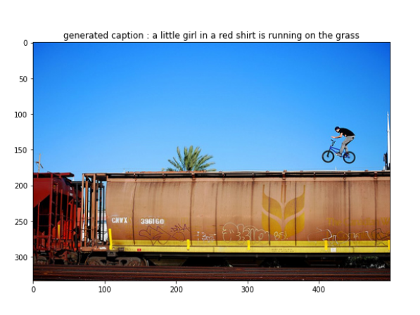
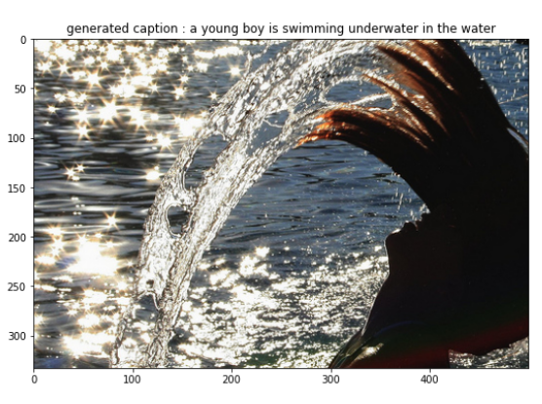
Some Results

Slide 33
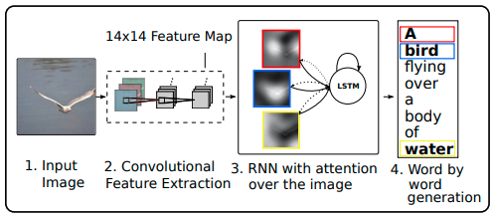
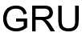
Image Caption Generation with Attention
The main structure of the model is similar to the last model shown, except for the fact that instead of using a RNN for decoding the image, we use a RNN with attention mechanism to decode the image.

Slide 34
The Attention mechanism:-
Attention is a technique that mimics cognitive attention.
With a visual attention model, the image is first divided in to n parts, and with a CNN, we compute the representations of each part. When the RNN is generating a new word, the attention mechanism is focusing on the relevant part of the image, so the decoder only uses specific parts of the image

Slide 35
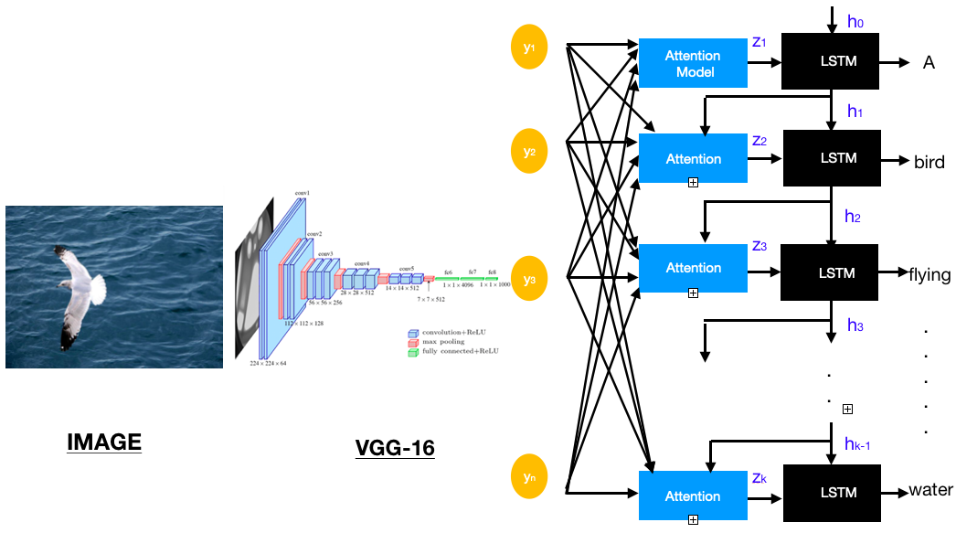
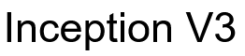
The Attention mechanism:-

Slide 36
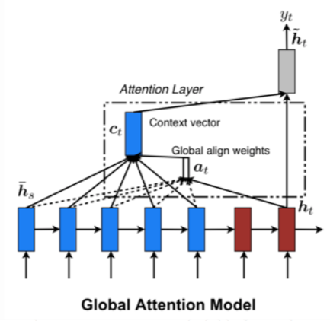
The Attention mechanism:-
Global Attention:-
Here, attention is placed on all source positions. Global attention takes into consideration all encoder hidden states to derive the context vector.

Slide 37
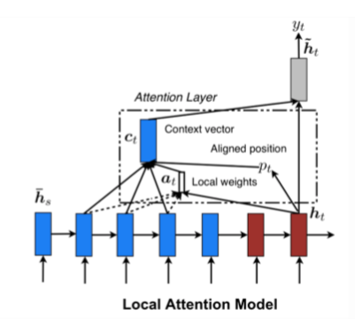
The Attention mechanism:-
Bahnadeu’s Attention (Local Attention):-
Global attention focus on all source side words for all target words, it is computationally very expensive and is impractical when translating for long sentences. To overcome this deficiency local attention chooses to focus only on a small subset of the hidden states of the encoder per target word.

Slide 38
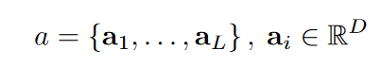
How attention really works:-
We use a convolutional neural network in order to extract a set of feature vectors which we refer to as annotation vectors. The extractor produces L vectors, each of which is a D-dimensional representation corresponding to a part of the image.

Slide 39
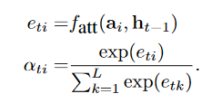
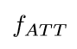
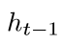
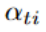
How attention really works:-
Next, using attention, we try to figure out where the model should look for next in the picture depending on the words which have already been generated.
Where is the attention model, is the hidden layer for the RNN (here, it represents the previous words).
Also is the probability distribution for each i we get by using softmax.

Slide 40
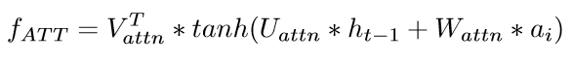
How attention actually works:-
is a simple feed forward neural network which is a linear transformation of the input, then a non linearity (tanh) put over it, and then again one more transformation. Note that is a scalar quantity.

Slide 41
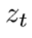
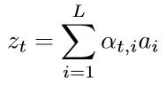
How attention really works:-
Now that we have for all the parts of the image and the feature vectors, we take a weighted sum, and pass this weighted sum, and the previous state of
the decoder and the previous word through the RNN to generate the next word.

Slide 42
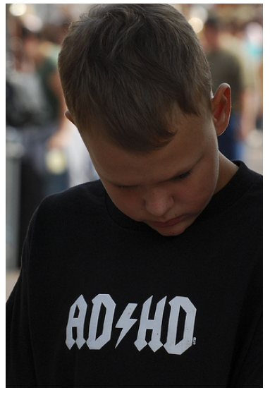
How attention really works:-

Slide 43
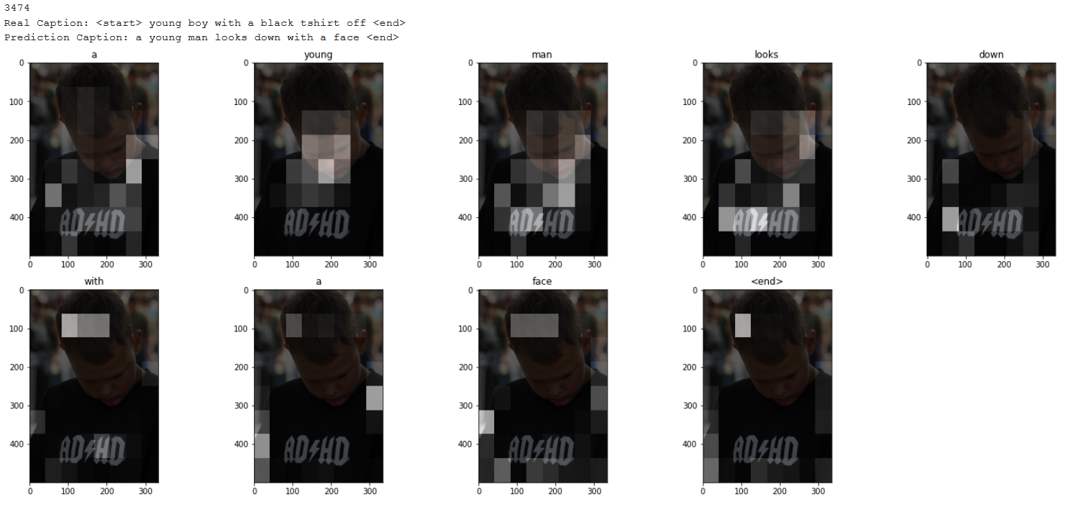
How attention really works:-

Slide 44
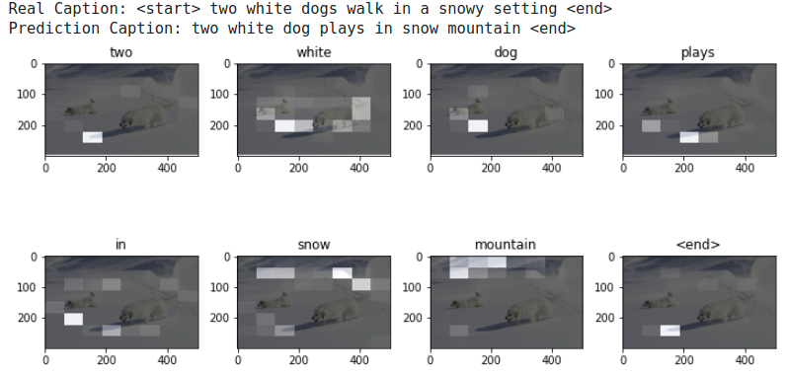
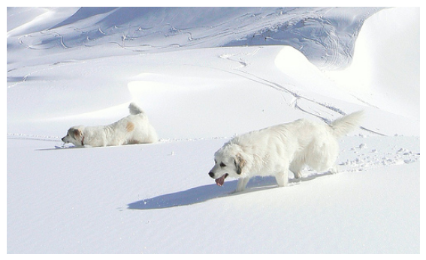
Some Results:-

Slide 45
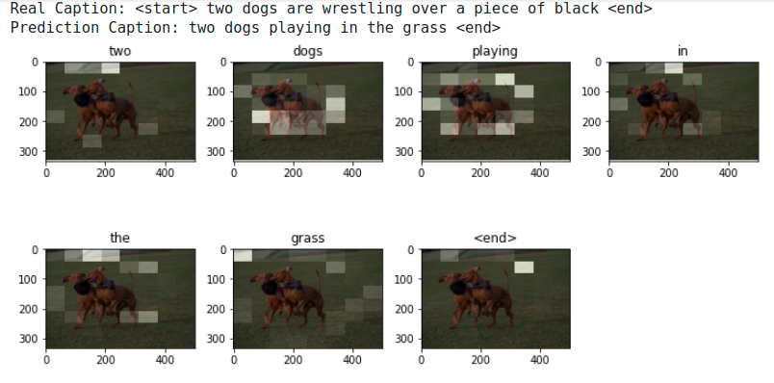
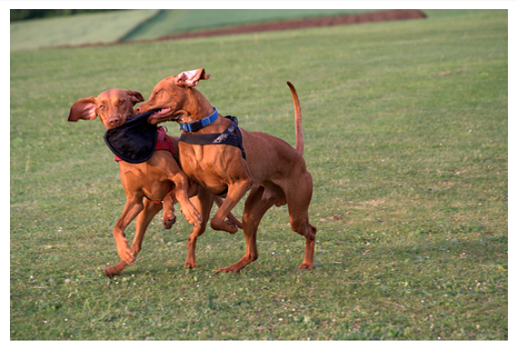
Some Results:-

Slide 46
Evaluate for the attention model:-
Test set consisted of 2428 images.
First compared scores for first 200 test images
BLEU B-1: 0.44
BLEU B-2: 0.23
METEOR: 0.31
Also noted average scores for whole test set:
BLEU B-1: 0.42
BLEU B-2: 0.22
METEOR: 0.30

Slide 47
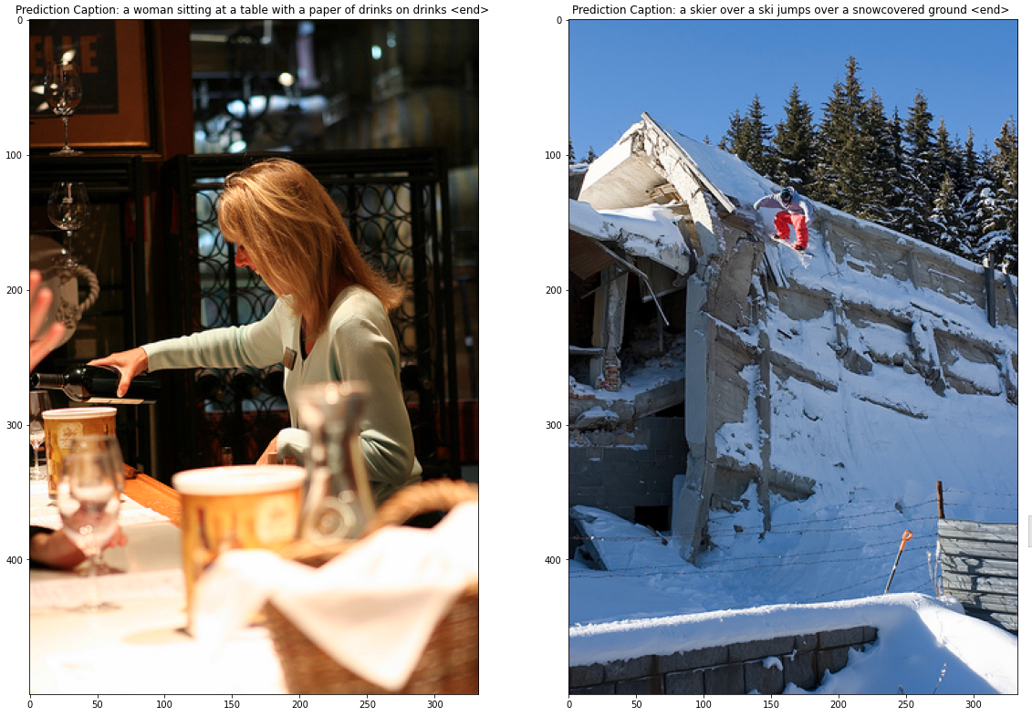
Some Results:-

Slide 48
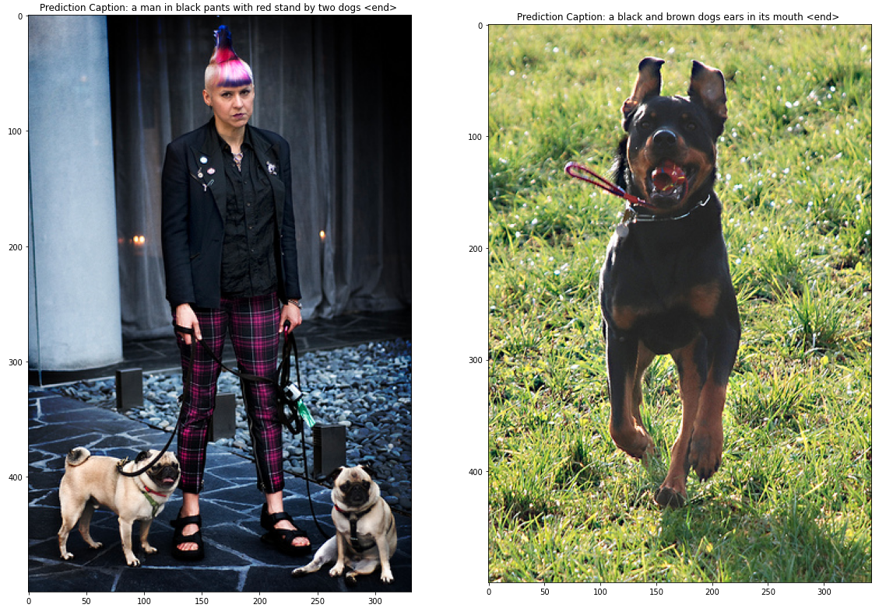
Some Results

Slide 49
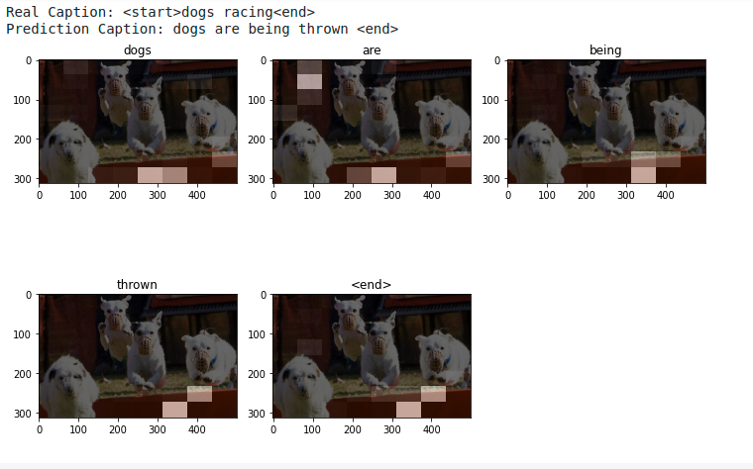
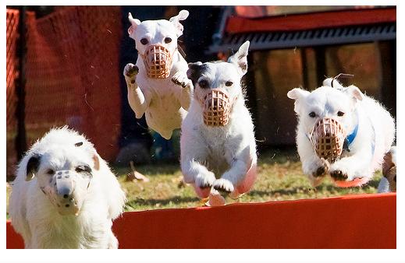
Some results:-

Slide 50
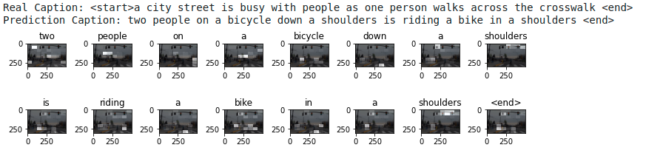
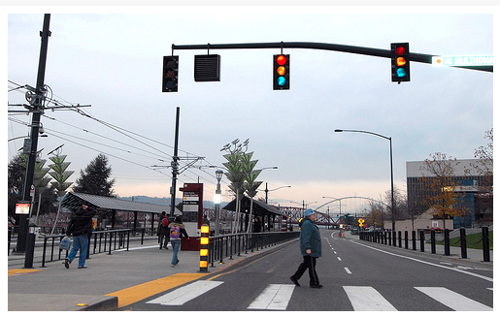
Some results:-

Slide 51
Conclusion and Future works
We got familiar with the overview of how an image caption system works.
The results obtained are by no means perfect but is still decent considering the challenging nature of the problem.
We touched upon introducing attention to the captioning model by using visual attention.
For future works, one can explore the semantic attention too.
For further enhancements, there is a scope to train further layers of the pretrained Inception encoder custom to the dataset that we want our caption model to train on.

Slide 52
Code Links
Initial run on small data (first 100 images of flickr30k) : Colab Notebook Link
Best Model with Greedy Search (flickr8k - 8091 images): Colab Notebook Link
Model with Greedy and Beam Search implementations: Colab Notebook Link
Model with Attention mechanism: Colab Notebook Link

Slide 53
References
Oriol Vinyals, et al. Show and tell: A neural image caption generator.
Kelvin Xu, et al. Show, attend and tell: A neural image caption generator with visual attention.
https://machinelearningmastery.com/calculate-bleu-score-for-text-python/
Kishore Papineni, et al. Bleu: a method for automatic evaluation of machine translation.
https://towardsdatascience.com/image-captioning-with-keras-teaching-computers-to-describe-pictures-c88a46a311b8
https://www.tensorflow.org/tutorials/text/image_captioning

Slide 54
Thank You

